Slide 1


Analyzing Financial Market Trends in R

Slide 2
Members
M.Nivien - 2023BCS0054
Shaun Alan Joseph - 2023BCD0006
Venkat Jaswanth - 2023BCD0021

Slide 3
Introduction
This project applies data mining and time-series techniques to historical stock data for AAPL, GOOG, and MSFT (2020–2021) using R. The pipeline covers data acquisition, preprocessing, trend analysis via moving averages, volatility estimation, correlation analysis, and ARIMA forecasting. Findings highlight strong inter-stock correlations, volatility spikes during the COVID-19 market shock, and sustained upward trends across all three assets. The project demonstrates how core data warehousing concepts — windowed aggregation, ETL pipelines, and sequential pattern mining — map directly onto real-world financial analysis.

Slide 4
Libraries Used
quantmod — fetch & manage financial time-series data
TTR — technical indicators (SMA, EMA, rolling SD)
ggplot2 / plotly — static and interactive visualization
forecast — ARIMA modelling and forecasting
PerformanceAnalytics — portfolio return metrics
dplyr / zoo / xts — data wrangling and time-series handling

Slide 5
Dataset Used
Source: Yahoo Finance via getSymbols()
Stocks: AAPL, GOOG, MSFT — period: 2020–2021
adjustOHLC() corrects prices for splits and dividends
na.locf() forward-fills missing trading day values
Output: clean xts object with OHLCV columns

Slide 6
Return Distribution
After cleaning the data, daily returns are computed as the percentage change in closing price from one day to the next. These are plotted as a histogram to reveal the shape of price behavior over the two-year period. The distribution sits roughly centered at zero, but the tails extend further than a normal distribution would suggest — a well-known property of financial data meaning extreme single-day moves happen more often than standard models predict. This understanding underpins risk metrics like Value-at-Risk and the Sharpe Ratio.

Slide 7
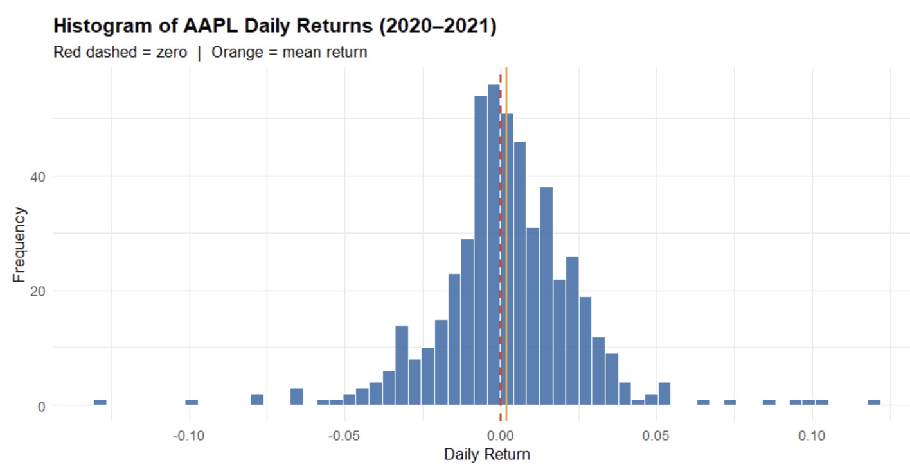

Slide 8
Moving Average Analysis
A 20-day and 50-day Simple Moving Average are computed for all three stocks and overlaid on their closing prices. The 20-day SMA reacts quickly to price changes while the 50-day captures the broader trend, and together they generate two widely used trading signals — the Golden Cross when the faster line crosses above the slower one indicating upward momentum, and the Death Cross for the reverse. Across all three stocks the SMAs confirm sustained upward trends through 2021 following the COVID-19 market shock.

Slide 9
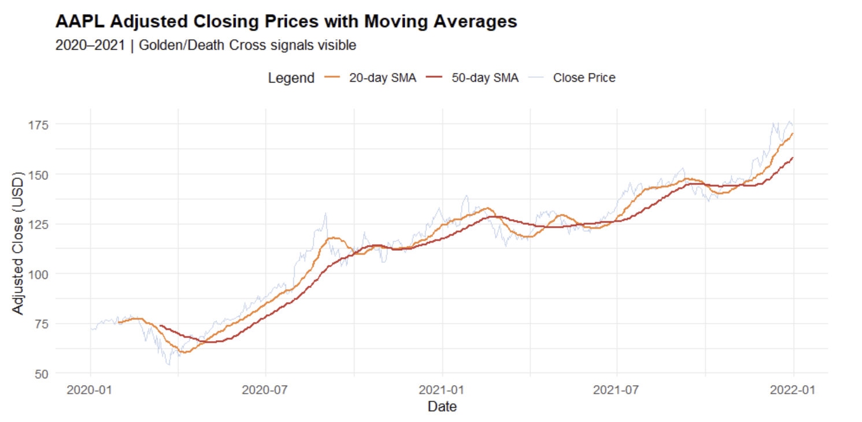

Slide 10
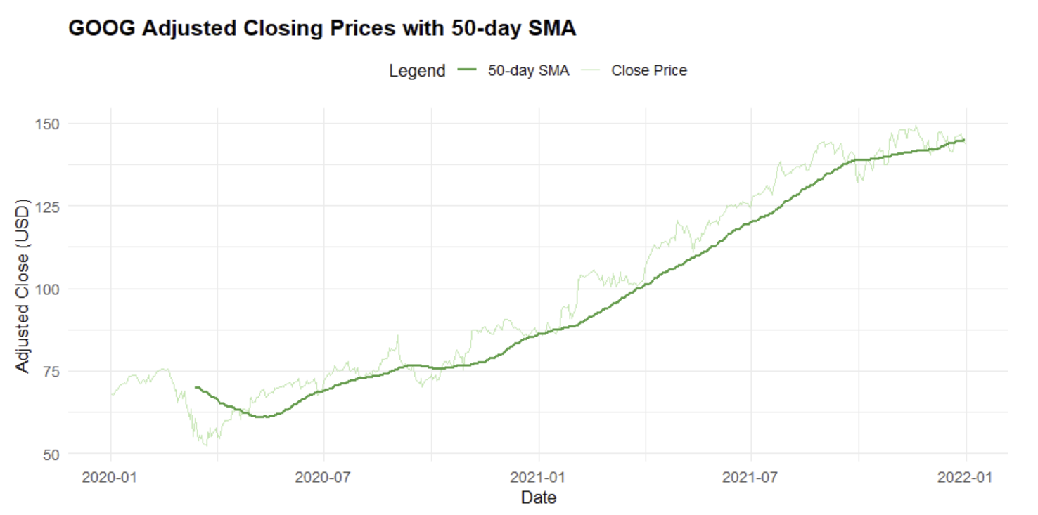

Slide 11
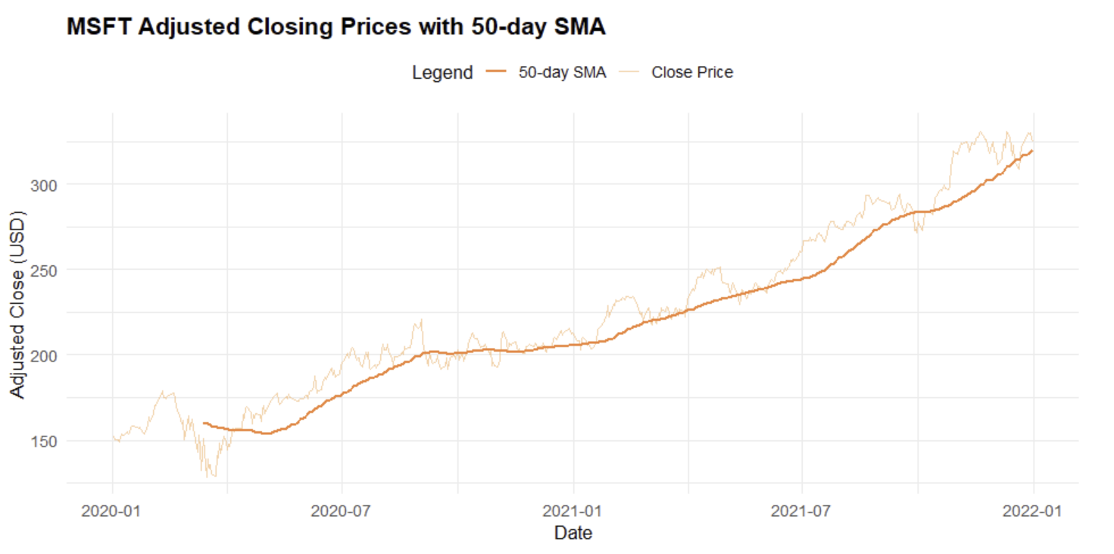

Slide 12
Volatility Analysis
A 20-day rolling standard deviation measures how much prices swing at any given point in time. The most striking feature is the sharp spike in March 2020 where volatility jumped six to eight times its normal level as markets reacted to COVID-19, with all three stocks spiking simultaneously — a clear sign of systemic market-wide risk rather than anything company-specific. Volatility normalized by mid-2020 and remained relatively stable through 2021. From a DWM perspective this rolling calculation is a direct application of sliding-window aggregation over ordered time-series data.

Slide 13
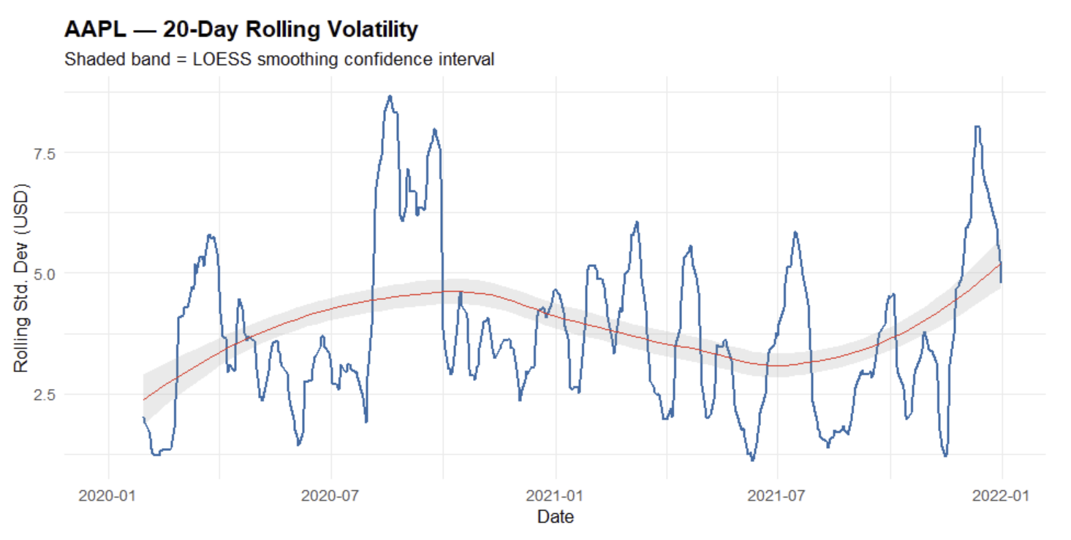

Slide 14
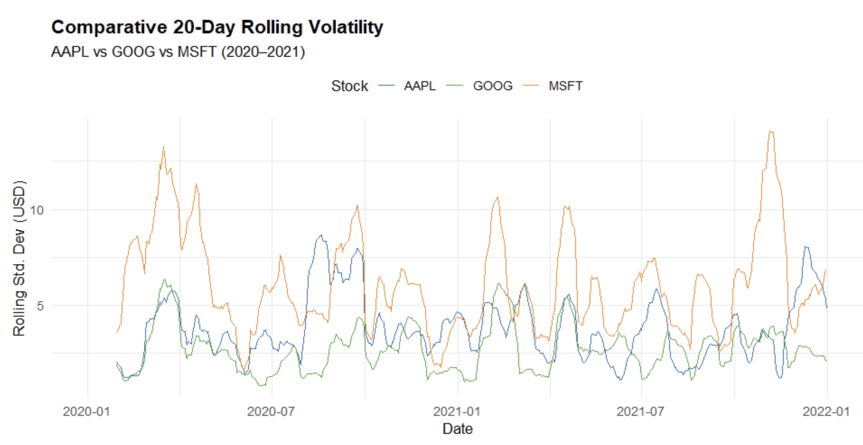

Slide 15
Correlation Analysis
Pairwise correlations between the daily log-returns of all three stocks are computed and displayed as a heatmap. All three pairs show strong positive correlation between 0.76 and 0.82, meaning they tend to rise and fall together. This illustrates the Markowitz diversification principle — holding multiple assets only reduces portfolio risk if those assets are weakly correlated, and three large-cap US tech stocks clearly do not provide that benefit relative to each other

Slide 16
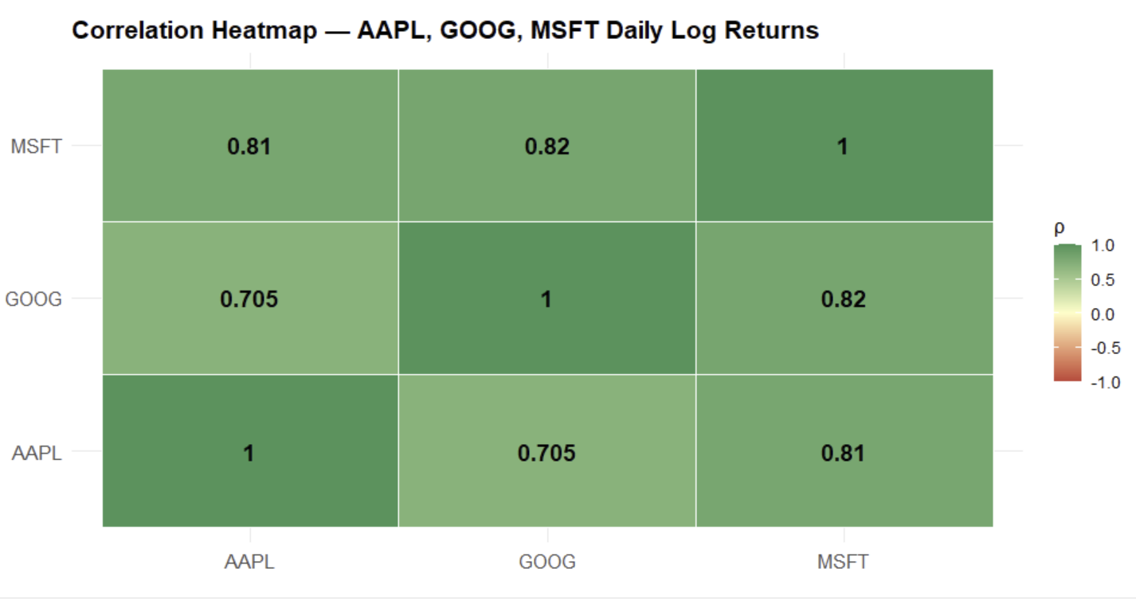

Slide 17
ARIMA Forecasting
An ARIMA model is fitted to Apple's closing price series to generate a 30-day forward forecast. The model combines autoregressive terms, differencing for stationarity, and moving average error correction, with auto.arima() automatically selecting the optimal parameters via AIC. The output includes 80% and 95% confidence intervals giving a probabilistic rather than point estimate, and residual diagnostics confirm the model errors resemble white noise, indicating a good fit.

Slide 18
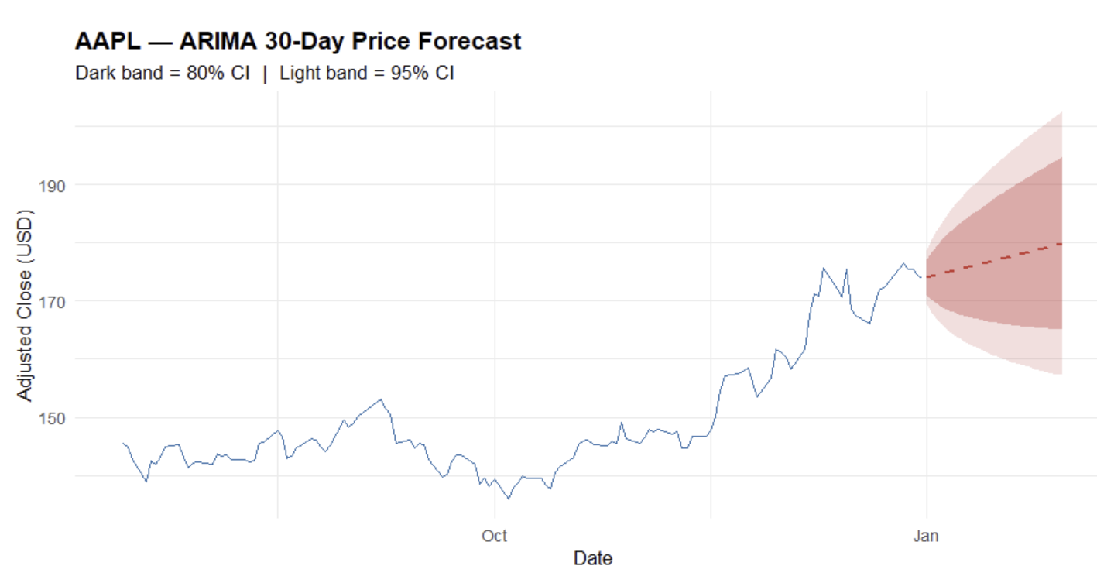

Slide 19
Interactive Visualization
A candlestick chart is built using Plotly, encoding each trading day's Open, High, Low, and Close values in a single glyph. The chart is fully interactive — hovering shows exact OHLC values, zooming and panning allow focus on any time window, and a range slider enables custom date selection. The output can be exported as a standalone HTML file, making it easy to share findings without requiring R to be installed.

Slide 20
Conclusion
A final comparison table shows Microsoft delivered the strongest return at roughly 106% over the two years, followed by Google at 89% and Apple at 82%, with annualised volatility similar across all three at 23–28%. The project as a whole demonstrates that core DWM concepts map naturally onto financial analysis — rolling aggregations mirror windowed SQL queries, the data pipeline mirrors ETL, and ARIMA is sequential predictive modelling applied to time-ordered data.

Slide 21
Thank You

